Slide 1

Radar resources
The following screen shots can be used as the basis of questions to gauge candidate understanding of basic principles of radar
These static images can be useful demonstrating or questioning:
  Display orientation
  Are true or relative vectors shown, and the significance and use of each?
  Assessing of collision?
    In questioning this area we need to ensure students understands the significant of whether or not they can see the vessel or they come under rule 19. We should use progressive scenarios for true decision making around colregs to avoid making decisions based on limited data.
The notes on each slide give some interpretation of the image which could be used as the basis of questions

Slide 2
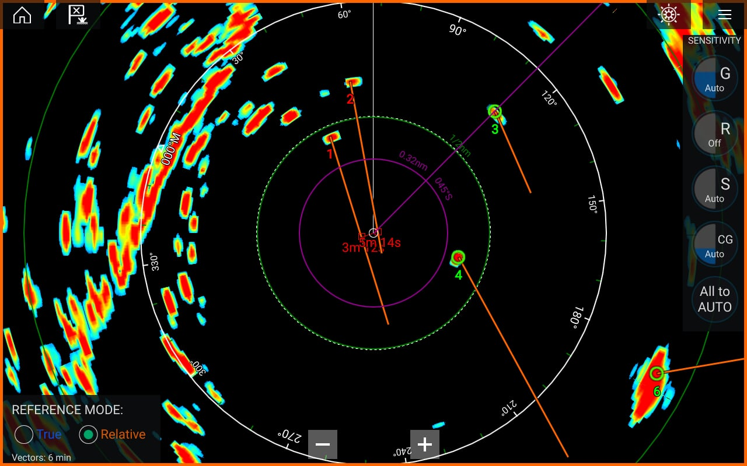
Notes:
Head up display or Course Up with heading mark exactly on course up mark
Relative motion (vessel in centre of screen)
Relative reference mode (relative vectors at 6 minutes). (MARPA or other tracking in use as targets are numbered)
Target 1 will cross very close to your stern in 3 minutes
Target 2 will cross your bow very close in approx. 4-5 minutes

Slide 3
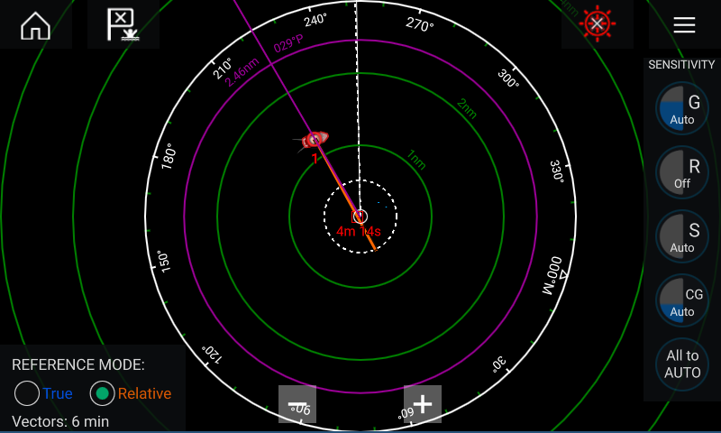
Notes:
Most likely Head up display (VRM is a relative bearing)
Relative motion Relative Vector set at 6 minutes( reference) mode
Target on is on a direct collision course with TCPA of 4 minutes 14seconds
Alter course to starboard

Slide 4
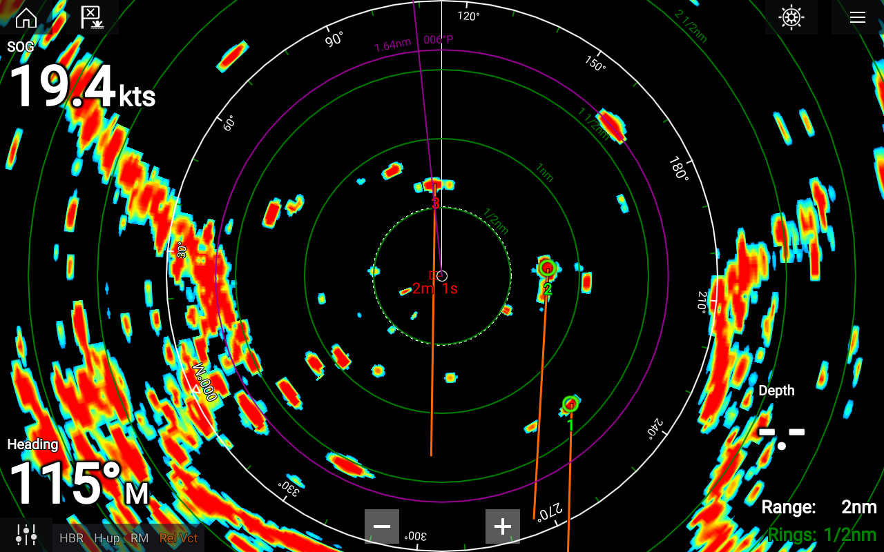
Notes:
Bottom Left:
Head up display (H-Up) although it has a course indicating ring which will be rotating in line with the targets as the head swings
Relative motion (RM)
Relative reference mode (Rel Vect)
Has target tracking enable with targets 1 to 3 labelled
Has one EBL/VRM active in Purple It is a relative reference of 006º to port – or 119 absolute from the outer bearing ring, 1.64 nautical miles (not nano metres)
Heading may be from GPS or Heading sensor – cannot tell, Has GPS input as it is showing COG.
Range nautical miles

Slide 5
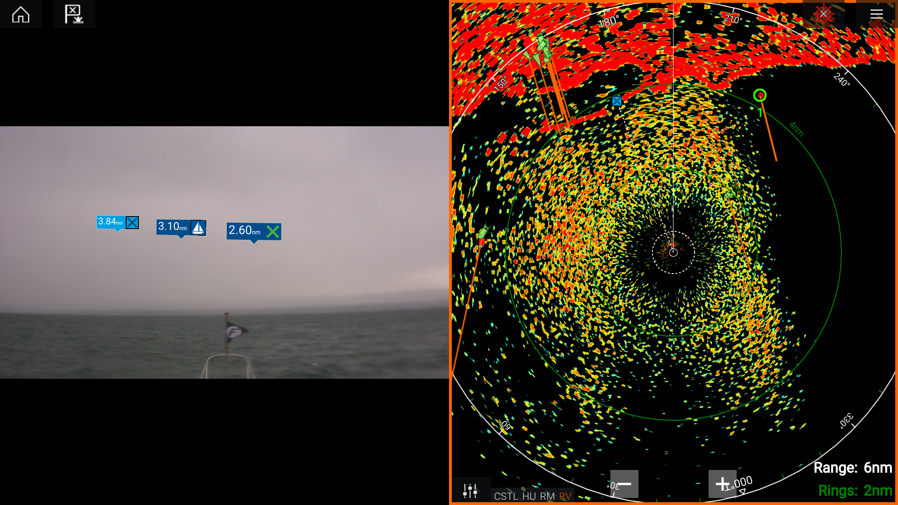
Notes:
Left screen shows an augmented reality image in front of the vessel with waypoint, marina and starboard lateral marks shown with their range. It appears to be poor visibility with rain in the distance.
Head up display
Relative motion (RM)
Relative reference mode (RV)
Rain filter is set too low. Targets may be lost underneath all the noise. AIS targets can be seen hidden in the rain so other vessels without AIS may be present as well.
Turn up the rain filter to clear the rain from the image and reveal any targets such as vessels, buoys, landmarks.
Radar using auto Coastal gain and clutter setting (CSTL).
Range 6 nautical miles, rings 2 nautical miles

Slide 6
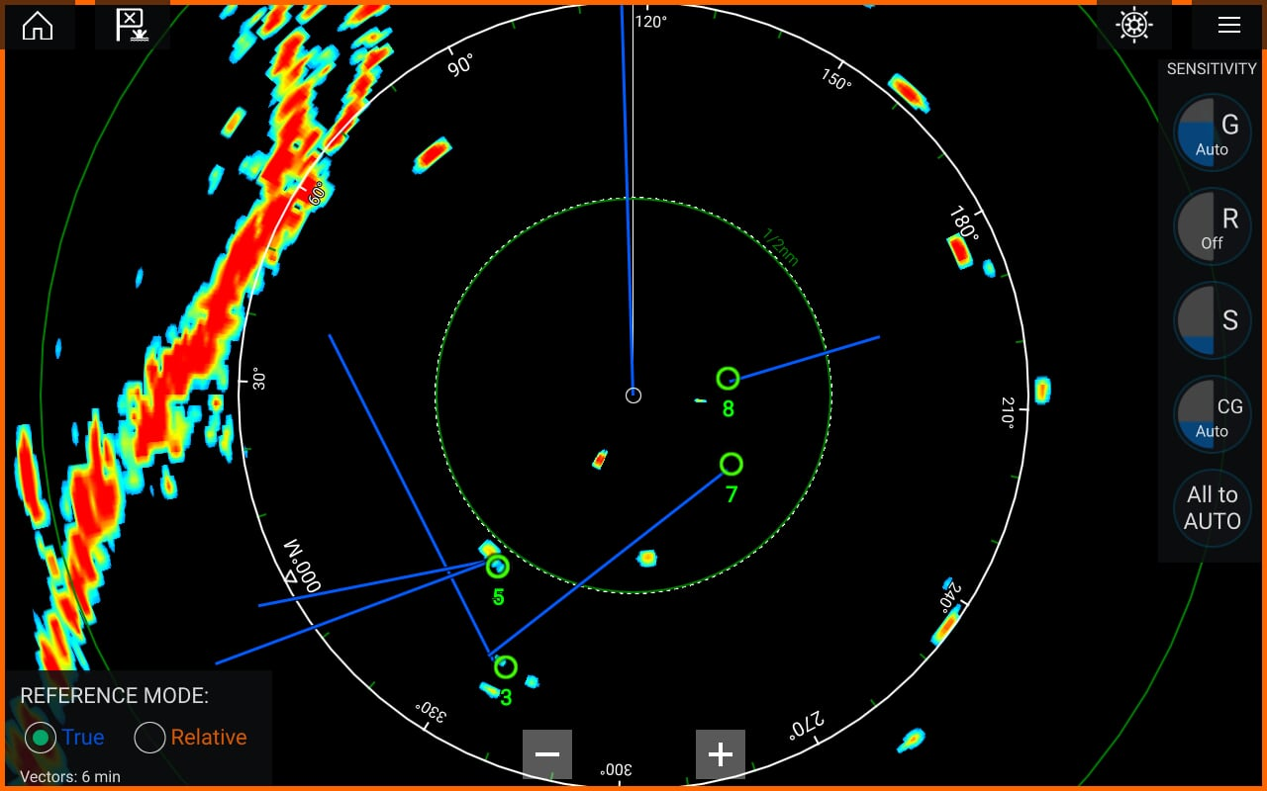
Notes:
Likely course up display as blue heading mark seen
Range appears to be 1 nautical mile with rings at 1/2 nautical mile.
Relative motion (vessel in centre of screen)
True vectors (reference mode) set to 6 minutes
Tracking enabled with no tracked vessel showing as risk of collision. Targets 5, 7 and 8 are moving away from us
Target 3 is moving in a similar direction to us and may over take us. Relative reference mode will give an indication of this.
Other targets movement unclear as no vectors or trails set. Without further information do not have full picture.

Slide 7
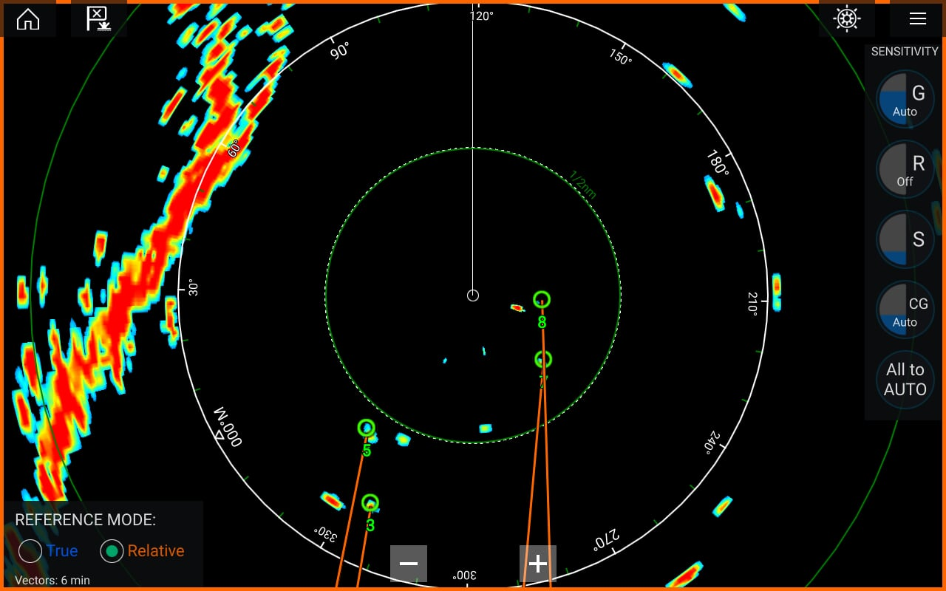
Notes:
Head up display
Relative motion (vessel in centre of screen)
Relative reference mode
All targets are abeam or behind us and we are moving away from them

Slide 8
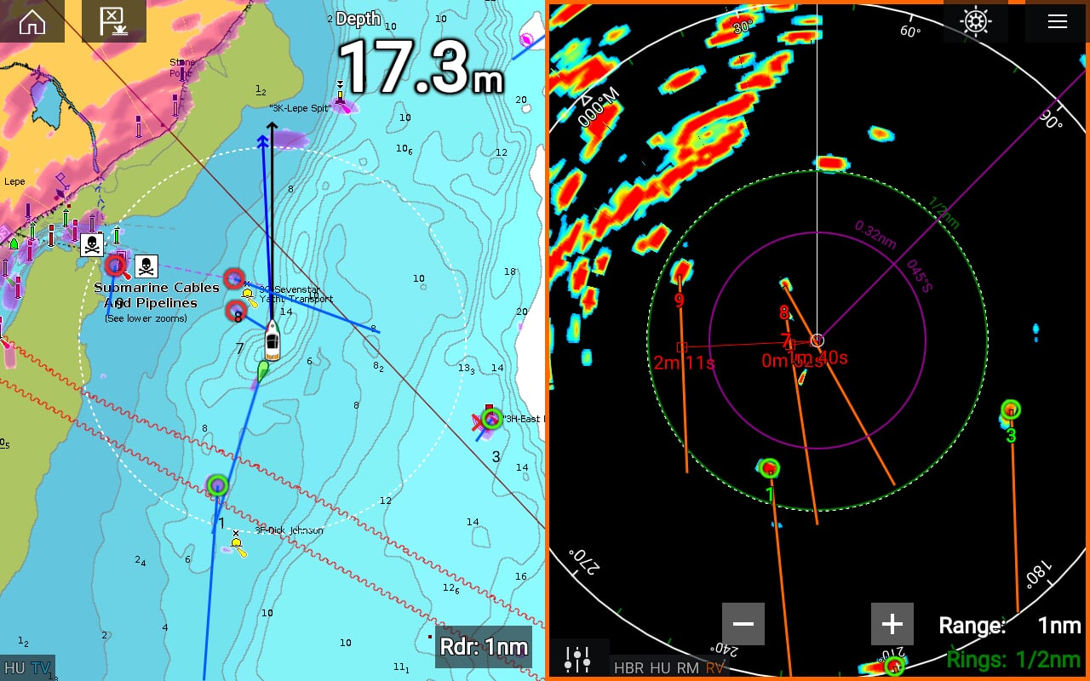
Notes:
Head up display (HU)
Relative motion (RM)
Relative vectors (reference mode) on radar (RV)
True reference mode on radar overlay on chart (blue vectors) (TV)
Targets 1, 3 and 9 are not a concern to us
Target 3 is a buoy. It appears to be moving on the radar image as it is in relative reference mode so it is moving relative to us.
There is a target shown directly on our bow to SW of the cardinal mark. Likely to be another vessel.
Target 7 appears to be on a collision course with us on chart however relative vector on radar image show it will pass down our port side, albeit extremely close.
Target 8 appears to be crossing our bow on chart however radar image shows relative vectors passing through our vessel (centre of screen) so we are on a collision course with them if neither vessel alters heading or course
If in visual contact make decision based on vessels in site, if not in visual contact rule 19 for vessels forward of the beam and detected by radar alone or with sound signal, although this is now a very close quarters situation.
Useful to show the difference between relative and true vectors

Slide 9
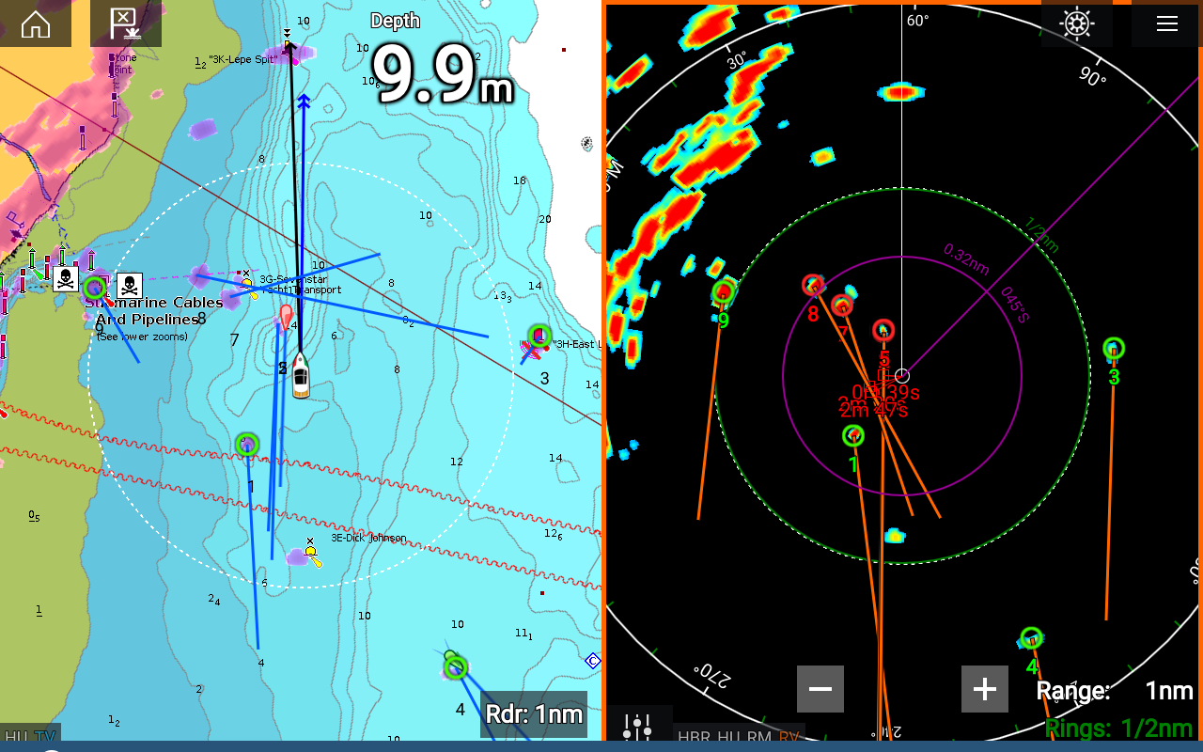
Notes:
Head up display
Relative motion (vessel in centre of screen)
Relative reference mode on radar (RM)
True reference mode on radar overlay on chart (blue vectors)(TV)
Targets 1, 3, 4 and 9 are not a concern
Target 3 is a buoy. It appears to be moving on the radar image as it is in relative reference mode so it is moving relative to us.
There is a target shown directly on our bow likely to be the cardinal mark seen on the chart.
There is a vessel to SW of the buoy which we should monitor
Target 5 (red AIS target) appears to be passing close down our port side. Radar image confirms this.
Target 7 and 8 appear to be crossing our bow on chart however radar image show their relative vector passing close behind our stern.
f in visual contact make decision based on vessels in site, if not in visual contact rule 19 for vessels forward of the beam and detected by radar alone or with sound signal, although this is now a very close quarters situation.
Useful to show the difference between relative and true vectors

Slide 10
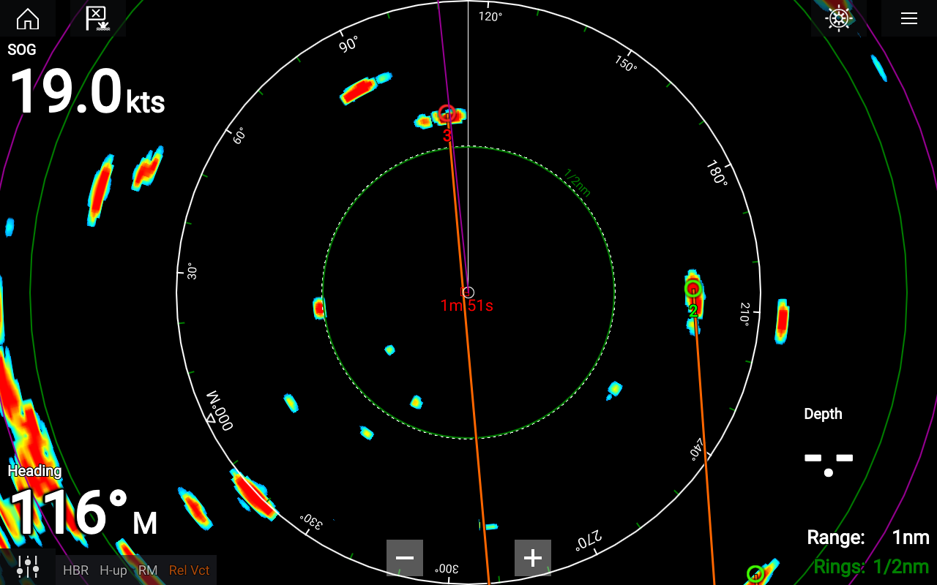
Notes:
Head up display
Relative motion (vessel in centre of screen) (RM)
Relative reference mode (RelVct)
Target 3 will pass very close down your port If in visual contact make decision based on vessels in site, if not in visual contact rule 19 for vessels forward of the beam and detected by radar alone or with sound signal, although this is now a very close quarters situation. Without knowing our speed to judge aspect or the true vector of the target we do not know if this is head on or overtaking or very slow crossing (e.g. fishing or drifting vessel).

Slide 11
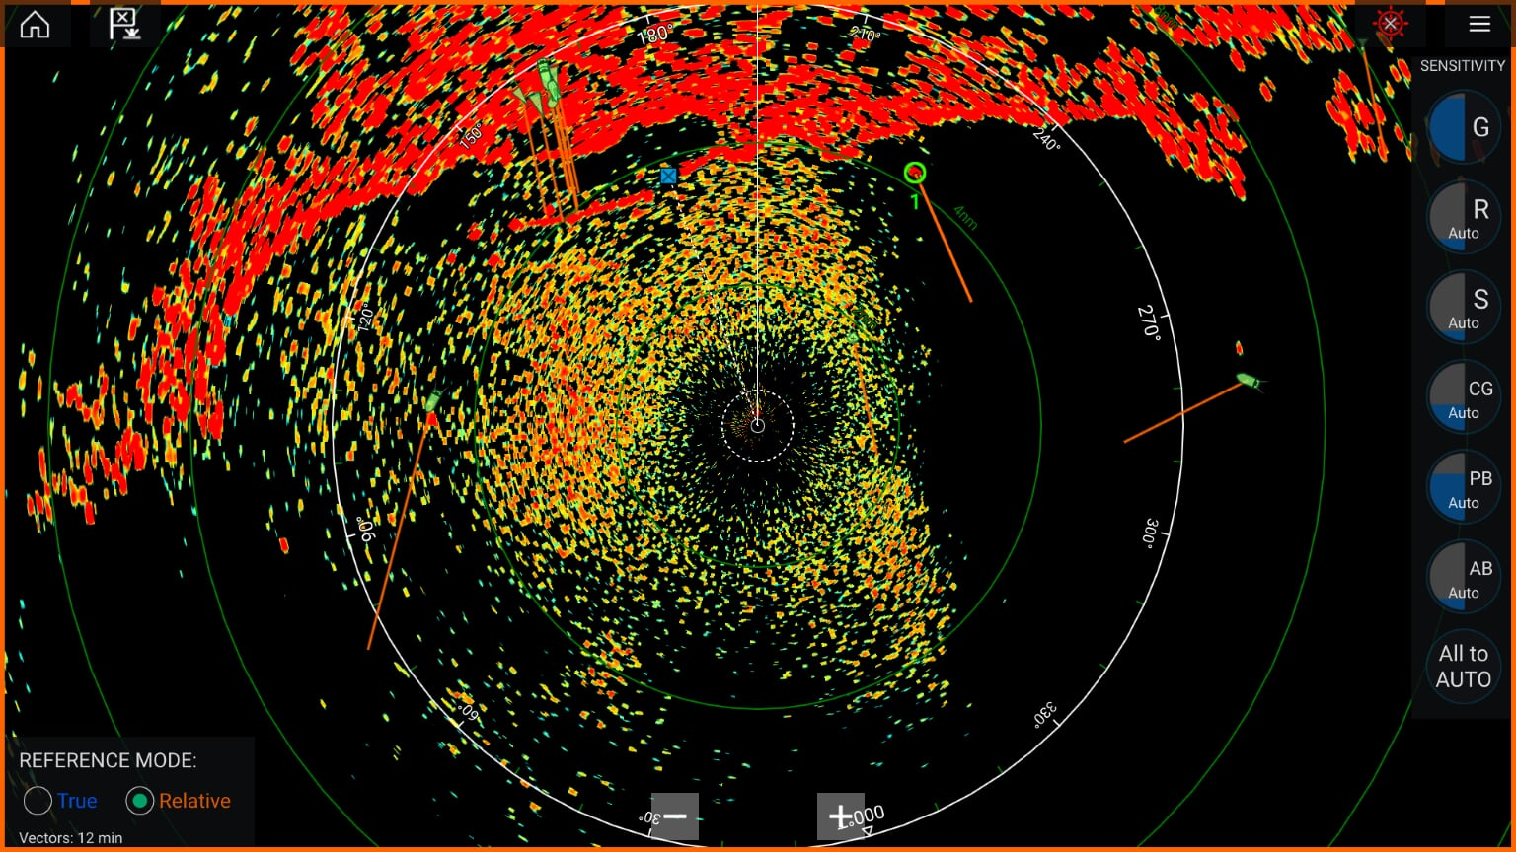
Notes:
Head up display
Relative motion (vessel in centre of screen)
Relative reference mode set to 12 minutes
Rain filter is set too low. Targets may be lost underneath all the noise. AIS targets can be seen hidden in the rain so other vessels without AIS may be present as well.
Turn up the rain filter to clear the rain from the image and reveal any targets such as vessels, buoys, landmarks.

Slide 12
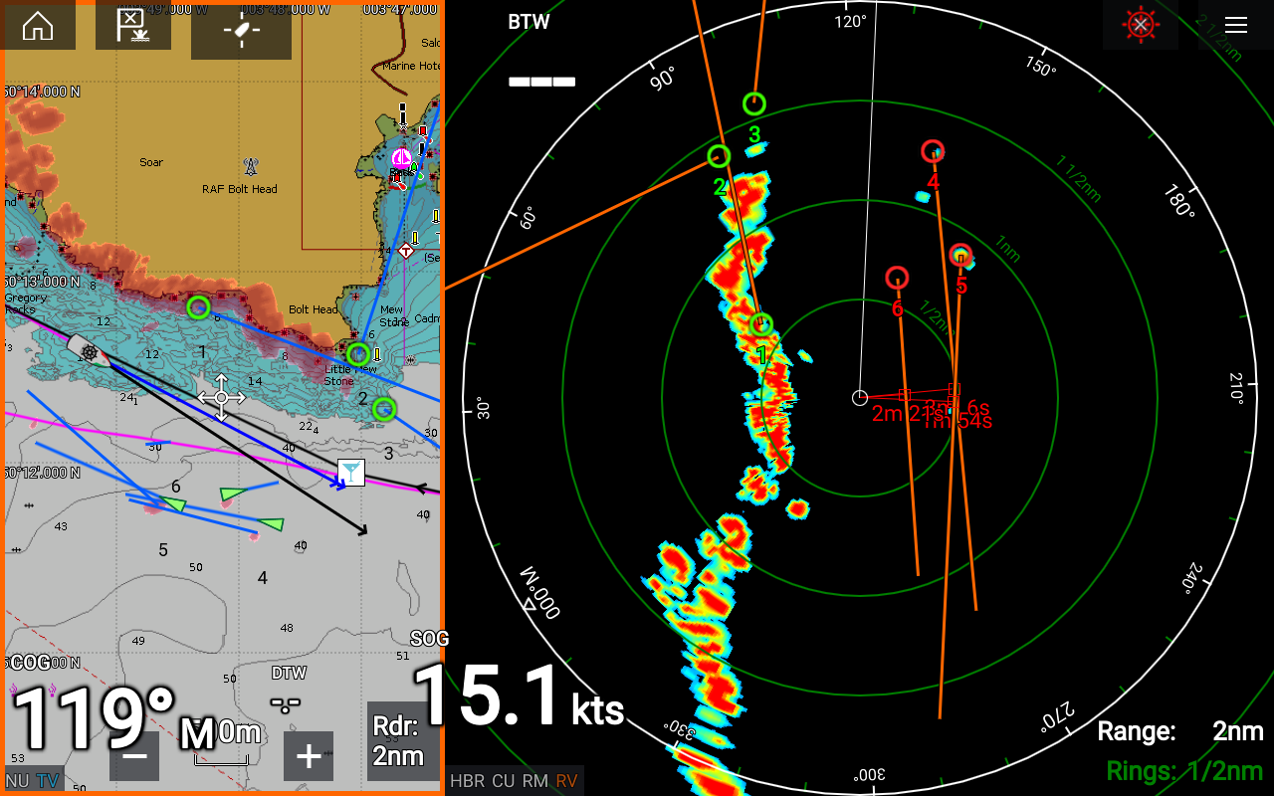
Notes:
Head up radar display
Relative motion (vessel in centre of screen)
Relative reference mode
Chart in North up with true reference vectors for AIS and radar
Radar shows radar targets 4, 5, and 6 will pass down our starboard side, 1, 2, and 3 will pass to port.
Maintain course, monitor radar and keep a good look out for other vessels.

Slide 13
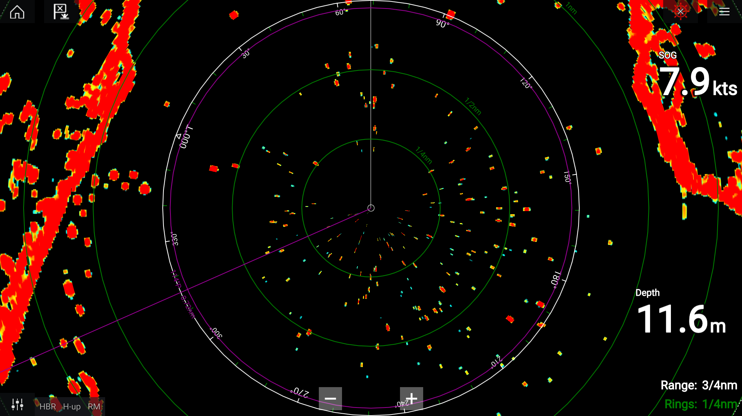
Notes:
Head up radar display (H-UP)
Relative motion (vessel in centre of screen) (RM)
Either you are surrounded by a lot of boats and mooring buoys or the sea clutter is set too low. Adjust the sea clutter to filter out the noise.

Slide 14
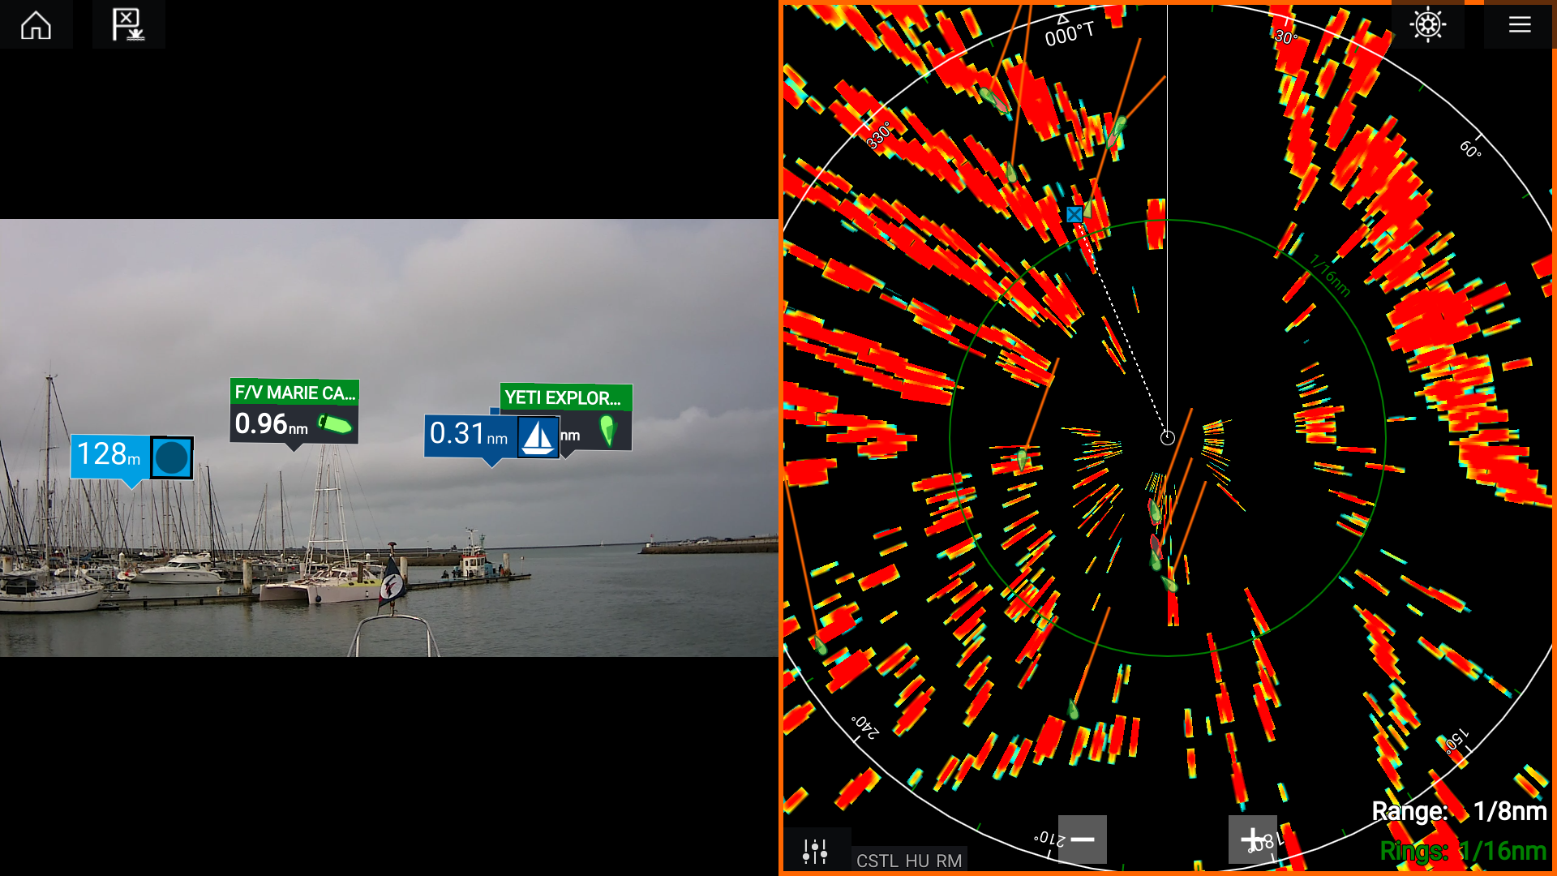
Notes:
Left screen shows an augmented reality image in front of the vessel with other AIS vessels, waypoint and marina shown with their range.
Head up radar display (HU)
Relative motion (vessel in centre of screen) (RM)
Your vessel appears to be moving backwards as all AIS targets appear to be moving forwards relative to you.

